Slide 1

Case Study : Airline ontime Performance using Big Data
Prem Vishnoi vishnoiprem@gmail.com, 18/01/29

Slide 2

Intro

Slide 3
Outline
Introduction to Airline on time Performance
Batch Ingestion & Processing
Hadoop directory Structure to be created.
Source data details
Data preparation
Batch Ingestion (HDFS)

Slide 4
Outline
Modeling and processing
Develop a solution in Hive, Pig and Spark/ Scala.
Speed Ingestion & Processing
Data preparation
Speed Ingestion and Modeling
Develop Restful service (Read data from Elastic search Index)…

Slide 5
Introduction to Airline on time Performance
The data consists of flight arrival and departure details for all commercial flights within the USA, from October 1987 to April 2008.
The performance of airline is measured by Hadoop ecosystem

Slide 6
Batch Ingestion & Processing
Layer | Directory Path | File Format | comments
RAW | /data/raw/ | CSV | 4 dir under /raw
Decomposed | /data/decomposed/ | Avro
Modelled | /data/modelled/Parquet | Parquet
Schema | /data/schema/ | AVSC schema

Slide 7
Source Data Details
Below are the source details
Airports-Airport name and airport code
Carriers-Flight Code and Name
Planedate
OTP- Online transaction Data

Slide 8
Data preparation
Airports
publish(topic, msg)
Consumer
subscribe
Airports
OTP
Airports
PlaneDate
msg
Carriers
OTP
Plane Date
Publish subscribe
system
Consumer
Carriers
msg
Notes:
Multiple subscribers, decoupling
Some examples : email notification on adding connection etc

Slide 9
Develop a solution in Hive, Pig and Spark/ Scala.
Which carrier performs better?
When is the best time of day/day of week/time of year to fly to minimise delays?
Do older planes suffer more delays?
Can you detect cascading failures as delays in one airport create delays in others? Are there critical links in the system?

Slide 10
What is pub sub ?
Producer
publish(topic, msg)
Consumer
subscribe
Topic 1
Topic 2
msg
Topic 3
Publish subscribe
system
Consumer
Producer
msg
Notes:
Multiple subscribers, decoupling
Some examples : email notification on adding connection etc

Slide 11
Kafka
Distributed
Persistent
High throughput

Slide 12
Hadoop Data Load for Kafka
Live data center
Offline data center
Hadoop
Hadoop
Dev Hadoop
Frontend
Kafka
Kafka
Frontend
Kafka
Kafka
Real time consumers
Kafka
Kafka
Hadoop
Hadoop
PROD Hadoop
Notes:
Give some background on – basically generating business reports
Tracking data is crucial to measure user engagement – unique member visits per day, ad metrics CTR to ad publishers
Also data analytics – new models for PYMK
Collapse multple boxes into one. Show multiple Hadoop clusters
If you track some new data, it will automatically reach Hadoop in a few minutes.

Slide 13
Multi DC data deployments
Live data centers
Offline data centers
Real time consumers
Kafka
Hadoop
Real time consumers
Hadoop
Real time consumers
Hadoop
Hadoop
Real time consumers
Kafka
Hadoop
Real time consumers
Hadoop
Real time consumers
Hadoop
DWH

Slide 14

Volume
10B events/day
1 terabytes/day
100K events/sec

Slide 15
Architecture
Producer
Producer
Broker
Broker
ZK
Broker
Broker
Consumer
Consumer

Slide 16
Outline
Introduction to pub-sub
Kafka at LinkedIn
Hadoop and Kafka
Design
Performance

Slide 17
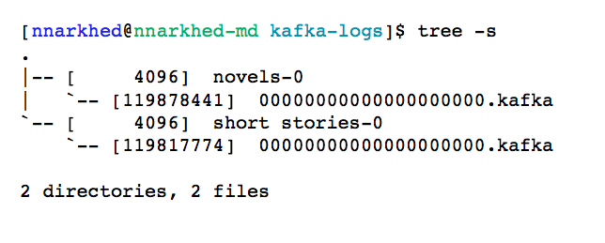
Efficiency #1: simple storage
Each topic has an ever-growing log
A log == a list of files
A message is addressed by a log offset
Notes:
One topic is enough

Slide 18
Efficiency #2: careful transfer
Batch send and receive
No message caching in JVM
Rely on file system buffering
Zero-copy transfer: file -> socket

Slide 19
Multi subscribers
1 file system operation per request
Consumption is cheap
SLA based message retention
Rewindable consumption

Slide 20
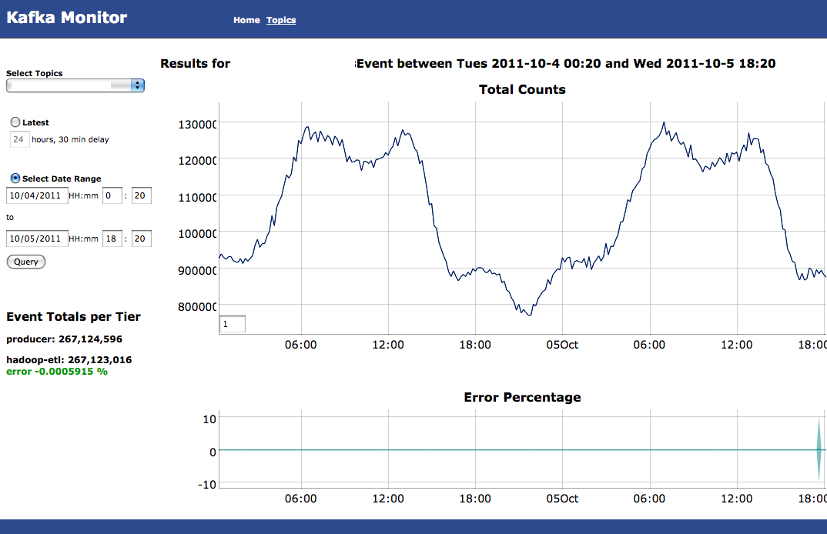
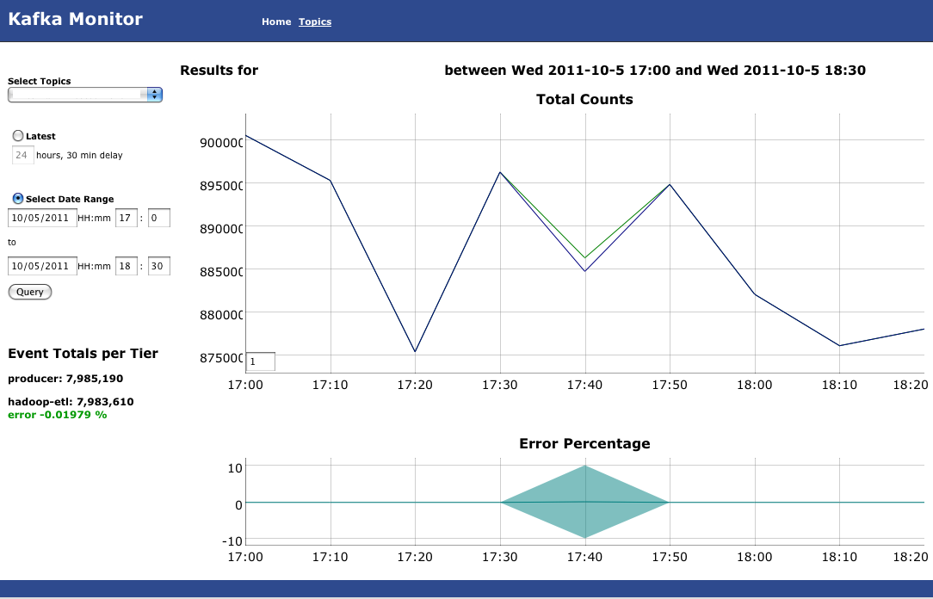
Auditing
# events published = # events consumed

Slide 21
Performance
2 Linux boxes
16 2.0 GHz cores
6 7200 rpm SATA drive RAID 10
24GB memory
1Gb network link
200 byte messages
Producer batch size 200 messages

Slide 22
Basic performance metrics
Producer batch size = 40K
Consumer batch size = 1MB
100 topics, broker flush interval = 100K
Producer throughput = 90 MB/sec
Consumer throughput = 60 MB/sec
Consumer latency = 220 ms
Notes:
s

Slide 23

Replication

Slide 24
Speed Ingestion and Modelling
Model in Elasticsearch (Index, Type, Partition)
Consume the data from Kafka topic and load in to speed (Elasticsearch) using Spark streaming

Slide 25
Develop Restful service (Read data from Elasticsearch Index), Answer any three of the following questions…
Which carrier performs better?When is the best time of day/day of week/time of year to fly to minimise delays?Do older planes suffer more delays?Can you detect cascading failures as delays in one airport create delays in others? Are there critical links in the system?

